Slide 1


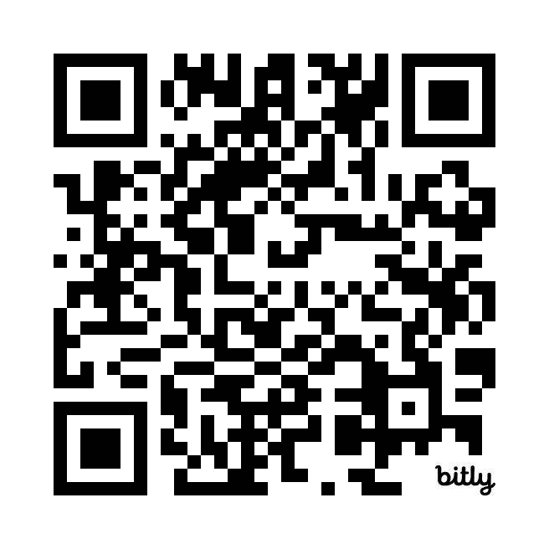
Psychological First Aid (PFA)
Introduction to Psychological First Aid for the GO Health Medical Reserve Corps
1 of 2 Required MRC Trainings
Preview the online course here!
Version 11.2025

Slide 2

During times of great stress, personal interactions will have a great impact.
What TYPE of impact do you want to make?

Slide 3
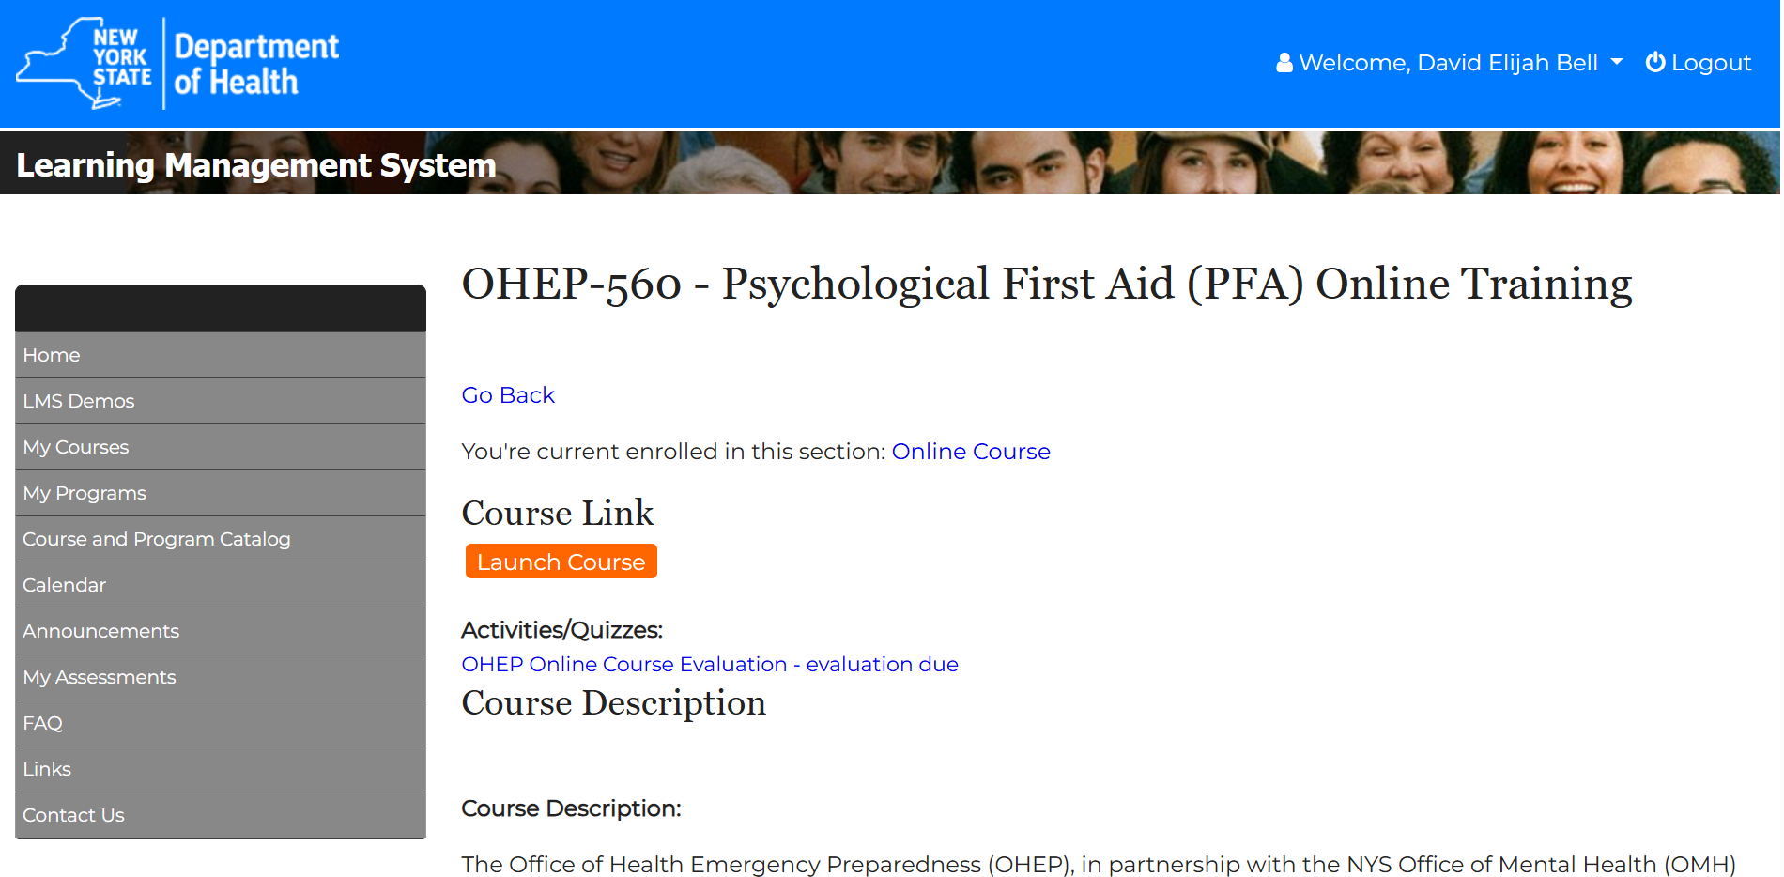
A GO Health MRC Training Associated with the OHEP-560 PFA Online Training on the NYS Learning Management System

Slide 4
What Is Psychological First Aid (PFA)?
A practical, evidence-based approach meant to reduce symptoms of stress in others, and assist in their healthy resilience and/or recovery
A framework for interacting with others at times of crisis or trauma
A set of strategies used primarily by non-mental health providers to assist with immediate needs of mental health duress

Slide 5
PFA: A Universal Intervention
Who can use PFA? Anyone who is trained and comfortable with the evidence-based strategies used in PFA. There is no federal certification, and training is managed by appropriate agencies. While mental healthcare professionals may use similar techniques in emergencies, PFA is meant to be used primarily outside of mental health settings.
Who can get PFA? PFA can help anyone, including people of all ages, families, individuals, disaster survivors, and responders
Where and When? PFA can be used anywhere and anytime, including during disasters, everyday emergencies, or personal crises
Purpose: PFA is a supportive approach used in all interactions to address immediate physical and emotional needs, helping people return to stability as quickly as possible.

Slide 6

Psychological First Aid Is Not
PFA is NOT debriefing, counseling, or treatment
It is NOT professional help, nor replacement for professional help
It is essential to recognize the limits of PFA and understand when to refer someone for professional mental healthcare!

Slide 7
Remember to Know Your Limits
Recognize what you can and can not do in terms of comfort and competence (ability)
Be aware of mental health resources for those in greater need
Do not feel bad that you can not address every need you encounter
Respect the wishes of those who do not want your help

Slide 8
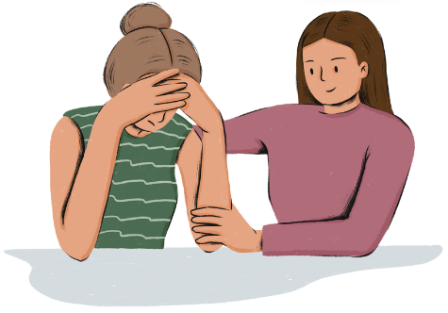
Why Is PFA Important? Helping Others
People recover better after a disaster or personal emergency if they:
Feel safe and connect with others
Have social, physical, and emotional support
Feel like they can help themselves and their communities

Slide 9
Why Is PFA Important? Your Role
What you say may not always have a positive impact, despite good intentions.
Training and remembering key principles can improve the likelihood of positive impact.
During times of stress, tensions are high, and impacts are more impressionable (lasting).
What you say and do can directly affect an individual, the degree of trauma they experience, and their healing process.
It is important to try and prevent further psychological harm in times of need.

Slide 10
PFA in Disasters

Slide 11
Reactions to Disaster
Range of Reactions:
Survivors and helpers may be surprised by the variety of responses to a disaster.
  Each person experiences different reactions, and those reactions can change over time
  Reactions by Type:
Emotional
Behavioral
Physical
Spiritual
Cognitive
These reactions can be intense and distressing for those experiencing them
Over time these reactions will likely fade for most people, becoming less frequent and less intense
Most people will feel better as time passes, but some may need professional mental health support if their symptoms are strong or long lasting

Slide 12

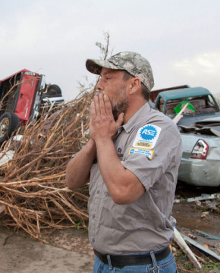
Identify Some Disaster Reactions
Notes:
Sadness
Shock
Despair
Numbness
Overwhelmed
Exhaustion
Grief
Anguish

Slide 13


Identify Some Disaster Reactions

Slide 14
Summary of Typical Reactions
Strong reactions to a disaster are normal and expected, but they don't always lead to conditions like PTSD. These reactions can feel overwhelming, so avoid minimizing them by just calling them "normal."
It may help to:
Acknowledge these feelings as painful but understandable given the situation.
Let people know that many others have similar strong reactions, and most improve over time.
Offer information on how to find someone to talk to if they’re not feeling better soon or need immediate help.
The goal is to validate their pain, offer hope for recovery, and provide resources for support now and in the future.

Slide 15
PFA Toolkit

Slide 16
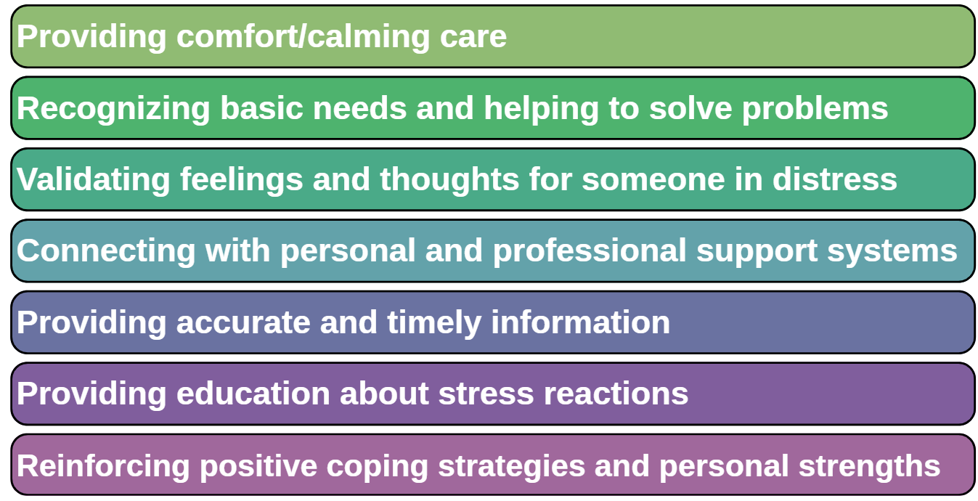
Elements of Psychological First Aid
PFA is not a process, but a toolkit of components to be used as needed, in any order appropriate
Depending on your role and timing in a response you may be more or less likely to use certain elements
It is still useful to understand the full range of possible PFA actions you might use to support someone under duress

Slide 17

Elements of Psychological First Aid
Provide comfort/calming care
Calm Yourself
  Disasters increase stress, and anxiety can spread
  Staying calm when talking with survivors often helps them stay calm too
  It can be difficult not to take on someone else’s emotions, so be sure to keep breathing deeply
Warmth and Genuineness
  Be kind and caring in all interactions
  Be attentive and use a soothing tone of voice no matter what is said back to you
  Pay attention to your body language:
    Sit or stand at eye level with the person
    Face them directly and keep an open posture
    Make eye contact, unless it makes them uncomfortable
    Stay focused on the conversation, and avoid looking around for other issues or people

Slide 18
Elements of Psychological First Aid
Recognizing Basic Needs
Disasters can be overwhelming, and this can affect judgement and decision-making. You can help by supporting those most impacted by this event.
Attending to Physiological Needs
Help make sure those who need medical care receive it
Make available and directly offer water, hot drinks, food, or blankets
Attending to Safety Needs
Ensure persons in distress feel safe enough to begin a recovery process
Protect them from ongoing threats, especially if they are disoriented
Encourage families and other close groups to stick to routines for stability
Assisting with Problem Solving
Persons in distress may be distracted or confused and struggle with decisions
Try to guide people towards productive choices, but still involve them in decision-making
When possible, offer choices instead of open-ended questions

Slide 19
Elements of Psychological First Aid
Validating Feelings and Thoughts
Experiencing a disaster is confusing for most people, and they may need help identifying and expressing their feelings.
Do not minimize someone’s loss, even if others may have suffered or lost more.
Providing Acknowledgement and Recognition
Survivors need acknowledgement that they have experienced a trauma, and that their stress reactions are understandable
Media presence can suggest that the situation deserves public attention, but also may feel intrusive or insensitive
Expressing Empathy
Empathy is understanding what someone is feeling, without feeling it yourself
If someone wants to talk about their difficult experience, listen, but do not force them to share if they are not ready
Be aware you may be exposed to their pain, loss, hopelessness, rage, shock, and other intense emotions
Have a plan to cope with your own feelings, like talking with your supervisor or other source of personal support

Slide 20
Elements of Psychological First Aid
Validating Feelings and Thoughts Continued: Expressing Empathy
Phrases that express empathy and help you understand what someone is trying to say:
If you get it wrong, just apologize and ask the person to clarify their point
These phrases should be avoided:
These sentiments might be well-intended but can still feel dismissive or minimizing to someone in distress. If someone shares painful stories or painful feelings, you do not want them to feel left alone or that their pain was ignored. Know your own limits and connect to an appropriate professional for help!
  “I hear you saying…”
  “It sounds like…”
  “It seems to you…”
  “You appear…”
  “Don’t feel bad.”
  “Don’t cry.”
  “Try not to think about it.”
  “Let’s talk about something else.”
  “I know how you feel.”
  “It’s God’s will.”
  “It could be worse.”
  “At least you still have.…”
  “At least [anything].”

Slide 21

Elements of Psychological First Aid
Connecting with Personal and Professional Support Systems
Persons in distress often find more immediate comfort from their own support networks than from professional ones, so reconnecting them with loved ones is important.
Social support can be:
  Instrumental (practical help)
  Emotional (comfort and care)
  Informational (guidance and advice)
Help Identify Social Support
If possible, reunite survivors with loved ones
Some may resist to reach out, thinking they are a burden. Ask, “What would you want if the roles were reversed?”
Help Avoid Negative Support
Not all relationships are supportive. Some can be sources of additional stress and burden.
When you encourage someone to reach out, first try to be sure that these contacts will not cause additional stress.

Slide 22
Elements of Psychological First Aid
Providing Accurate and Timely Information
Accurate and timely information is vital to reduce uncertainty and anxiety.
Include such information as:
  What happened? Who was responsible?
  Is it truly over?
  How bad was the damage?
  When can they return home?
  What recovery resources are available?
Keep updated lists of available resources, and present information in simple language
Provide information in writing if possible, and identify available language services
Never share unconfirmed news or unauthorized information
Saying “I don’t know” is better than potentially misleading someone

Slide 23
Elements of Psychological First Aid
Providing Education About Stress Reactions
Survivors often feel overwhelmed by their own emotional reactions to a disaster.
Providing education can:
  Normalize their reactions
  Explain why these reactions make sense given the circumstances
  Suggest ways to reduce and manage this stress
This “psychoeducation” is a key part of PFA, but can also be provided at any time
Don’t force information on those who don’t want it yet
Educate parents about children’s stress reactions, like regressing or becoming clingy, to help them stay patient, knowing these behaviors are temporary

Slide 24
Elements of Psychological First Aid
Reinforcing Positive Coping Strategies and Personal Strengths
Acknowledge and support someone’s strength, competence, courage, and power to begin to restore a sense of control
You can ask: “How have you gotten through tough times before?” or “What skills do you have that will allow you to get through this?”
If appropriate, find ways to allow some level of participation in response activities
Warn about ways of coping that make someone feel better temporarily but do not really help in the long-term
Encourage persons in distress to find ways that help them both feel and function better

Slide 25
Elements of Psychological First Aid
Reinforcing Positive Coping Strategies and Personal Strengths Continued
Effective Ways of Coping
  Getting enough sleep
  Taking breaks
  Eating a healthy diet
  Connecting with others
  Limiting TV exposure
  Exercising
  Allowing yourself to receive as well as give
  Using spiritual resources
  Balancing work, play, and rest
Ineffective Ways of Coping
  Not getting enough rest or sleep
  Overworking
  Binge eating
  Isolating yourself from others
  Watching too much television
  Drinking and smoking
  Attempting to regain a sense of control by becoming overly controlling or bullying those around you

Slide 26
Some Cautions When Using PFA with Disaster Survivors
Remember: Goal is to help survivors return to pre-disaster functioning, not fix all their problems.
Survivors of a disaster should not be treated identically; individual needs and cultural differences must be respected.
Some survivors prefer the comfort and support of peers or clergy, while others work their problems out alone or only want support from family members.

Slide 27
Psychological First Aid “Do’s and Don’ts”
DO | DON’T
Be realistic in your assurances | Over-promise or over-reassure
Validate the person’s feelings | Minimize the losses or make comparisons to others
Stay with the person’s focus | Change the subject
Learn to tolerate silence | Fill up silence with chatter
Accept that they may be venting and not really directing comments at you | Take anger or frustration personally

Slide 28
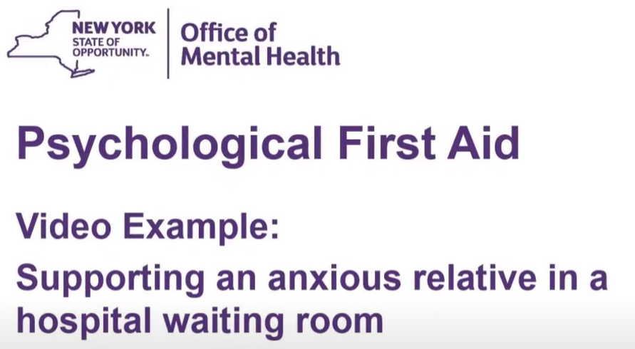
PFA Example Video
Psychological First Aid: Supporting an anxious relative in a hospital waiting room

Slide 29
Final Review:
Elements of Psychological First Aid

Slide 30
Knowledge Check
True or False: It is important to deliver Psychological First Aid elements in the order outlined.
  True
  False

Slide 31
Knowledge Check
What is the main concern for helpers who respond to survivors with sympathy rather than empathy?
  They can make survivors feel weak or helpless
  They risk experiencing vicarious trauma
  They won’t be able to connect effectively with survivors

Slide 32
Knowledge Check:
Who do you think you might be able to use PFA with in your work or personal life? Select all that apply:
  Disaster Survivors
  Clients or patients
  Colleagues
  Family Members
  Friends
  Strangers

Slide 33
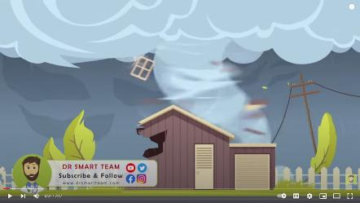
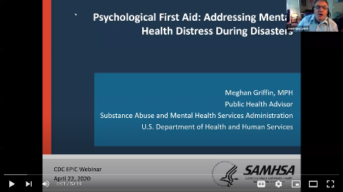
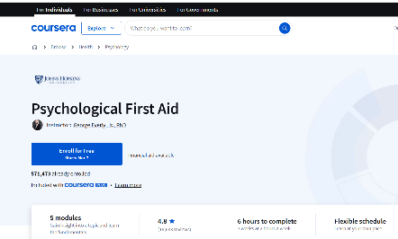
Additional PFA Resources
Dr. SMART Team on YouTube
Psychological First Aid - Support during mental trauma, natural disasters, wars, mass crime
Center for Disease Control and Prevention (CDC) –
Psychological First Aid: Addressing Mental Health Distress During Disasters
Psychological First Aid: Addressing Mental Health Distress During Disasters - YouTube
Johns Hopkins Coursera for Psychological First Aid
(Free enrollment and learning but paid final exam with certificate)
https://www.coursera.org/learn/psychological-first-aid

Slide 34
How to complete the NYS PFA training online and get your certificate:
To take this course, you will need a New York State (NYS) Learning Management System (LMS) account.
Follow this link to the ‘OHEP-560 - Psychological First Aid (PFA) Online Training’: https://bit.ly/4gcBUOe
Log-in or create an account and enroll in the course.
Click “My Courses” and launch the course.
After completing the training, return to “My Courses”. Use the drop-down menu in the top right to select “My Completed Courses”. Complete the course evaluation and view your certificate.
Email the certificate to GOHealthMRC@orleanscountyny.gov

Slide 35

Thank you!

Slide 36
Quiz Time!

Slide 37
True or False:
Psychological First Aid is providing counseling.

Slide 38
True or False:
Psychological First Aid is providing counseling.

Slide 39
You meet a natural disaster survivor who tells you they’re hungry. You bring them a sack lunch that has been made up for community members.
Which key element is this an example of?
      Providing comfort/calming care
      Validating feelings and thoughts
      Providing accurate and timely information
      Recognizing basic needs and helping to solve problems

Slide 40
You meet a natural disaster survivor who tells you they’re hungry. You bring them a sack lunch that has been made up for community members.
Which key element is this an example of?
      Providing comfort/calming care
      Validating feelings and thoughts
      Providing accurate and timely information
      Recognizing basic needs and helping to solve problems

Slide 41
True or False:
Psychological First Aid is to be used only at the immediate disaster/emergency location.

Slide 42
True or False:
Psychological First Aid is to be used only at the immediate disaster/emergency location.

Slide 43
A survivor tells you that they have become separated from their partner during a tornado. You inform them on the current response efforts to locate survivors and that a shelter has been put in place where community members can reconnect.
Which key element is this an example of?
      Connecting with personal and professional support systems
      Validating feelings and thoughts
      Providing education about stress reactions
      Providing comfort care

Slide 44
A survivor tells you that they have become separated from their partner during a tornado. You inform them on the current response efforts to locate survivors and that a shelter has been put in place where community members can reconnect.
Which key element is this an example of?
      Connecting with personal and professional support systems
      Validating feelings and thoughts
      Providing education about stress reactions
      Providing comfort/calming care
*Providing accurate and timely information would also work here

Slide 45
A survivor tells you that they feel useless after a natural disaster has struck their community. You brainstorm with them and help them come to the conclusion to donate blood at the nearby Red Cross truck.
Which key element is this an example of?
      Providing comfort/calming care
      Validating feelings and thoughts
      Providing education about stress reactions
      Reinforcing positive coping strategies and personal strengths

Slide 46
A survivor tells you that they feel useless after a natural disaster has struck their community. You brainstorm with them and help them come to conclusion to donate blood at the nearby Red Cross truck.
Which key element is this an example of?
      Providing comfort/calming care
      Validating feelings and thoughts
      Providing education about stress reactions
      Reinforcing positive coping strategies and personal strengths

Slide 47
Congratulations!!!

