Slide 1
ICS 100: Introduction to the Incident Command System
An Introduction to the incident command system for the GO Health VALOR Medical Reserve Corps
2 of 2 Required MRC Trainings
Preview the online course here!
Version 2.2025

Slide 2
Understand the process so you can be part of the solution
… especially during unprecedented situations.

Slide 3
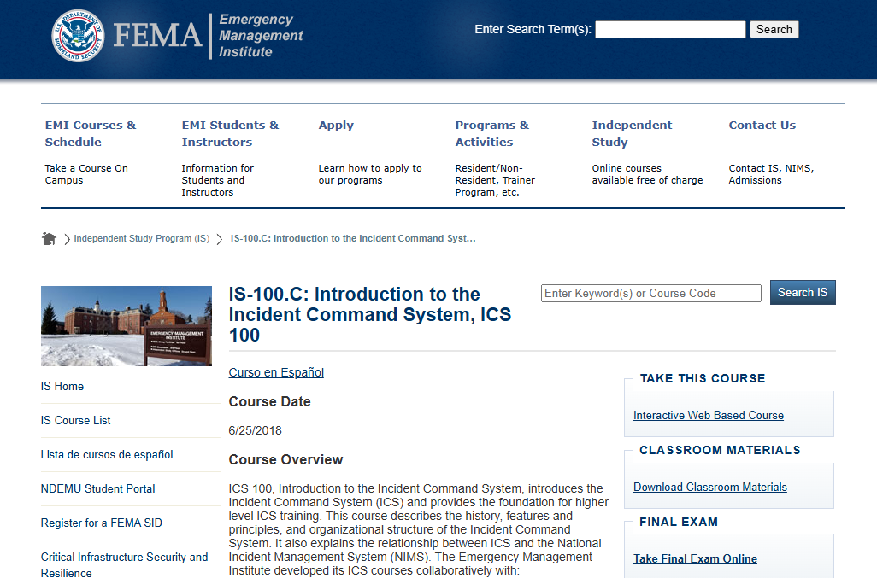
A GO Health MRC Training Associated with IS-100.C: Introduction to the Incident Command System, ICS 100 course with FEMA

Slide 4
Online Course Structure
Unit 1: Course Welcome and ICS Overview
Unit 2: NIMS Management Characteristics
Unit 3: ICS Functional Areas and Command Staff Roles
Unit 4: General Staff Roles
Unit 5: How ICS Applies to you

Slide 5
What is ICS?
The Incident Command System (ICS) is a flexible, standardized way to manage incidents that:
Is used for all kinds of incidents by all types of organizations and at all levels of government; ICS is applicable to small incidents as well as large and complex ones.
Can be used not only for emergencies, or for planned events.
Enables a coordinated response among various jurisdictions and agencies.
Establishes common processes for incident-level planning and resource management.
Allows for the integration of resources (such as facilities, equipment, personnel) within a common organizational structure.

Slide 6
Why is ICS 100 Important?
Having a better understanding of the ICS structure and process helps different agencies work together in unprecedented ways in times of emergency
A poorly managed incident response can be devastating to our economy, the food supply, and our health and safety. With so much at stake, we must effectively manage our response efforts.
ICS Helps Ensure:
The safety of responders, community members, and others
The achievement of incident objectives
The efficient use of resources

Slide 7
The Incident Command System:
Fosters new cooperation and collaboration
Clarifies the chain of command and supervision responsibilities
Improves accountability
Provides an orderly, systematic planning process with standardized concepts and terminology
Implements a common, flexible, predesigned management structure
Helps different agencies and people who are not used to working together in stressful situations to respond safely and effectively

Slide 8
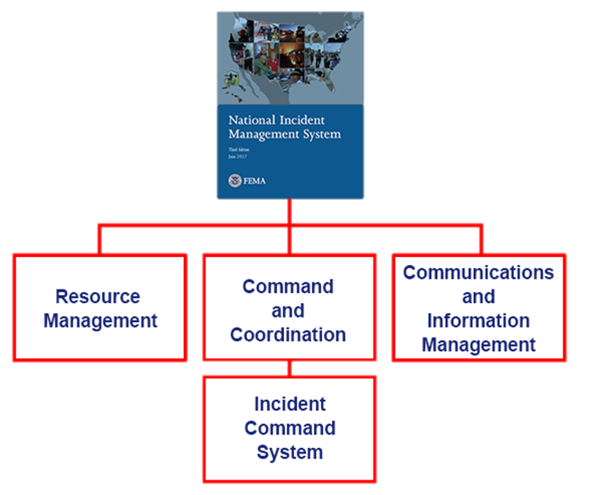
ICS is a Component of the National Incident Management System (NIMS)
The National Incident Management System (NIMS) helps governments, organizations, and businesses work together to prevent, respond to, and recover from incidents. It offers a clear plan for managing everything from everyday events to large emergencies that require federal assistance.
NIMS is organized into three major components:
Resource Management
Command and Coordination - including the Incident Command System
Communications and Information Management

Slide 9
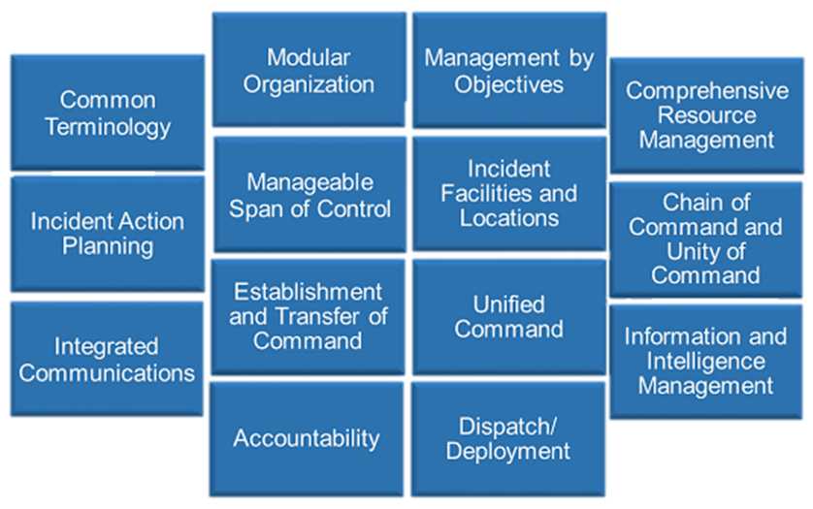
NIMS Characteristics
There are 14

Slide 10
ICS Structure
Incident Command
Public Information Officer
Liaison Officer
Command Staff
Safety Officer
General Staff
Operations Section
Planning Section
Logistics Section
Finance/ Administration Section

Slide 11
Chain of Command
Chain of command is an orderly line that details how authority flows through the hierarchy of the incident management organization.
Chain of command…
Allows an Incident Commander to direct and control the actions of all personnel on the incident
Avoids confusion by requiring that orders flow from supervisors
AUTHORITY

Slide 12
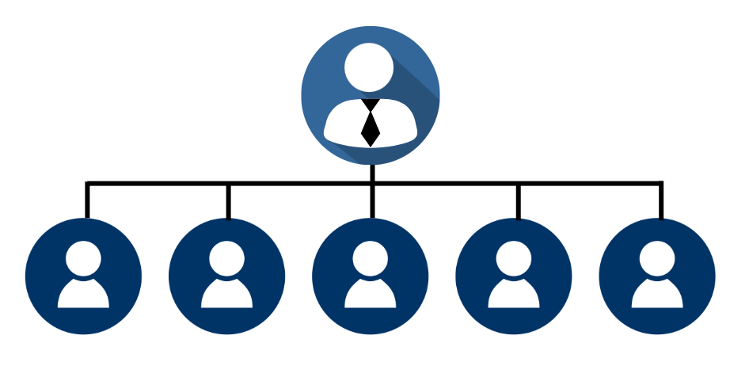
Manageable Span of Control
Depending on your role within the Incident Command System (ICS) structure, you may be asked to manage the activities of others.
Manageable Span of Control refers to the number of individuals, subordinates, or resources that one supervisor can manage effectively during an incident.
Supervisor
Resource
#1
Resource
#2
Resource
#3
Resource
#4
Resource
#5

Slide 13
Transfer of Command
When command is transferred, the process should include a briefing that captures all essential information for continuing safe and effective operations.
Who designates the process for transferring command?
The jurisdiction or organization with primary responsibility for the incident designates the Incident Commander and the process for transferring command

Slide 14
Management by Objectives
The Incident Commander or Unified Command establishes incident objectives that drive incident operations.
Management by Objectives includes the following:
Establishing specific, measurable incident objectives.
Identifying strategies, tactics, tasks and activities to achieve the objectives.
Developing and issuing assignments, plans, procedures, and protocols to accomplish identified tasks.
Documenting results for the incident objectives.
Incident Command
Public Information Officer
Liaison Officer
Command Staff
Safety Officer
General Staff
Operations Section
Planning Section
Logistics Section
Finance/ Administration Section

Slide 15
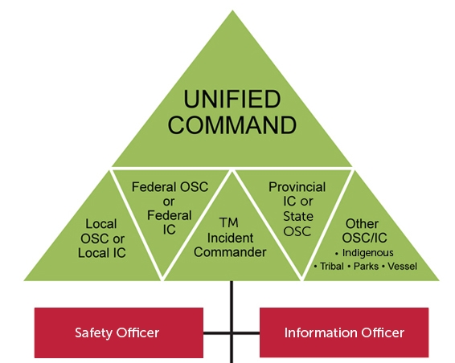
Unified Command
Instead of one incident commander, it becomes….
In a Unified Command there is no single "Commander." Instead, the Unified Command manages the incident through shared objectives. This allows different agencies to work together without losing their individual authority or responsibility.
Unified Command is used when no single agency has the authority or resources to handle the incident alone.

Slide 16
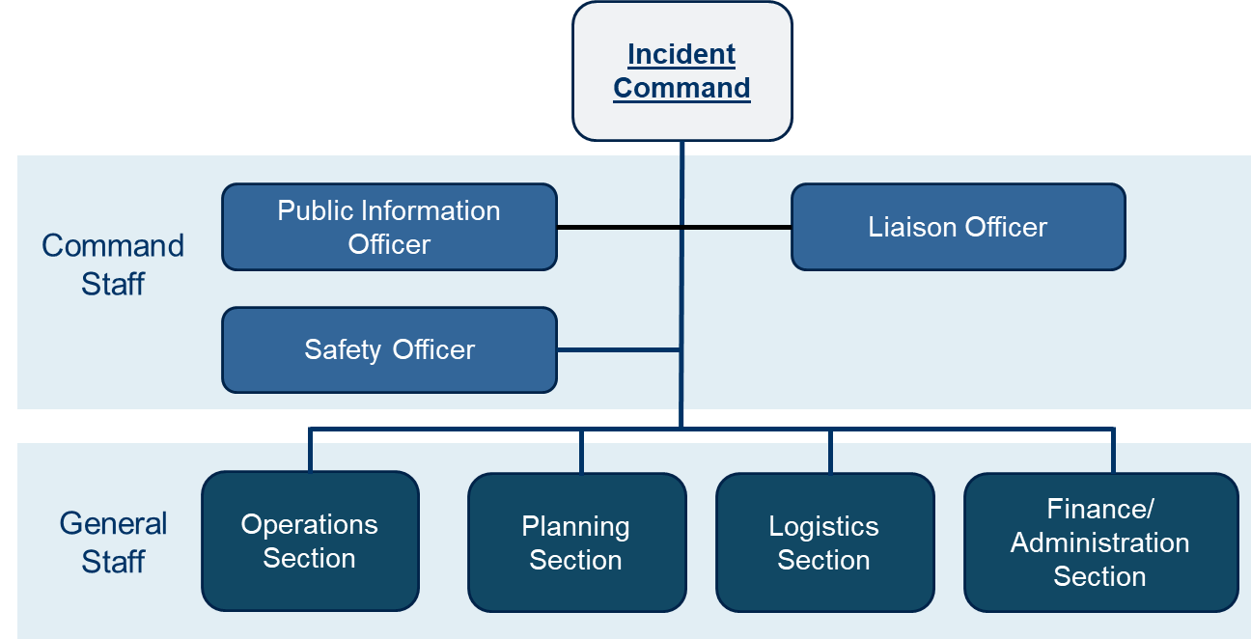
ICS Functional Area Descriptions
Incident Command: Sets the incident objectives, strategies, and priorities, and has overall responsibility for the incident.
The Incident Commander is responsible for the overall management of the incident. Overall management includes Command Staff assignments required to support the incident command function.
The Incident Commander is the only position that is always staffed in ICS applications.

Slide 17
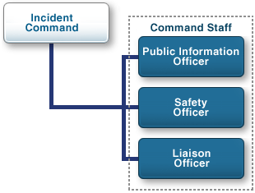
ICS Command Staff
Depending upon the size and type of incident or event, the Incident Commander may designate personnel to provide information, safety, and liaison services. In the Incident Command System (ICS), the Command Staff may include:
Public Information Officer, who interfaces with the public and media and/or with other agencies with incident-related information requirements.
Safety Officer, who monitors incident operations and advises the Incident Commander on all matters relating to safety, including the health and safety of incident management personnel.
Liaison Officer, who serves as the Incident Commanders point of contact for representatives of governmental agencies, non-governmental organizations (NGOs), and private-sector organizations.
The Command Staff reports directly to the Incident Commander.

Slide 18
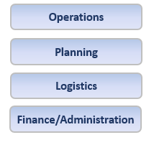
ICS Core Functional Area Descriptions
Operations: Conducts operations to reach the incident objectives. Establishes tactics and directs all operational resources.
Planning: Supports the incident action planning process by tracking resources, collecting/analyzing information, and maintaining documentation.
Logistics: Arranges for resources and needed services to support achievement of the incident objectives (resources can include personnel, equipment, teams, supplies, and facilities).
Finance/Administration: Monitors costs related to the incident. Provides accounting, procurement, time recording, and cost analyses.

Slide 19
How to complete the ICS100 training online and get your certificate:
To take this course and receive a certificate you will need a FEMA account.
Follow this link to the ‘IS-100.C:Introduction to the Incident Command System, ICS 100’ course: https://bit.ly/39GRvHW
Click the ‘Interactive Web Based Course’ link under ‘TAKE THIS COURSE’ and complete the training
After finishing the training, return to the main website and click the ‘Take Final Exam Online’ link under ‘FINAL EXAM’.
Log-in or create an account and complete the final exam.
Email your certificate to David.Bell@geneseeny.gov or Cora.Young@orleanscountyny.gov

Slide 20
Quiz!

Slide 21
Incident objectives that drive incident operations are established by:
Agency Administrator
Planning Section Chief
Operations Section Chief
Incident Commander or Unified Command

Slide 22
Incident objectives that drive incident operations are established by:
Agency Administrator
Planning Section Chief
Operations Section Chief
Incident Commander or Unified Command

Slide 23
Which ICS functional area sets the incident objectives, strategies, and priorities, and has overall responsibility for the incident?
Finance/Administration
Command
Operations
Logistics

Slide 24
Which ICS functional area sets the incident objectives, strategies, and priorities, and has overall responsibility for the incident?
Finance/Administration
Command
Operations
Logistics

Slide 25
How many NIMS Management Characteristics are there?
12
13
14
15

Slide 26
How many NIMS Management Characteristics are there?
12
13
14
15

Slide 27
If the Incident Commander designates personnel to provide public information, safety, and liaison services, the personnel are collectively referred to as the:
Command Staff
Director Staff
Incident Staff
Executive Staff

Slide 28
If the Incident Commander designates personnel to provide public information, safety, and liaison services, the personnel are collectively referred to as the:
Command Staff
Director Staff
Incident Staff
Executive Staff

Slide 29
To ensure a smooth transfer, the outgoing Incident Commander should provide a(n) ___________ to the new Incident Commander.
Situational Analysis Document
Lessons Learned Report
Briefing
Incident Action Plan

Slide 30
To ensure a smooth transfer, the outgoing Incident Commander should provide a(n) ___________ to the new Incident Commander.
Situational Analysis Document
Lessons Learned Report
Briefing
Incident Action Plan

Slide 31
Congratulations!

Slide 32
Thank you!

